Slide 1
Chapter 3 – Data Visualization
Data Mining for Business Analytics in R
Shmueli, Bruce, Yahav, Patel & Lichtendahl

Slide 2
Graphs for Data Exploration
Basic Plots
Line Graphs
Bar Charts
Scatterplots
Distribution Plots
Boxplots
Histograms

Slide 3
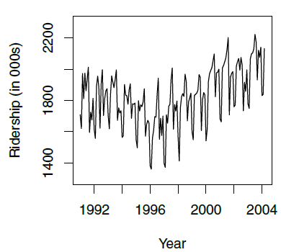
Line Graph for Time Series Amtrak Ridership
# use time series analysis
library(forecast)
ridership.ts <- ts(Amtrak.df$Ridership, start = c(1991, 1), end = c(2004, 3), freq = 12)
plot(ridership.ts, xlab = "Year", ylab = "Ridership (in 000s)", ylim = c(1300, 2300))

Slide 4
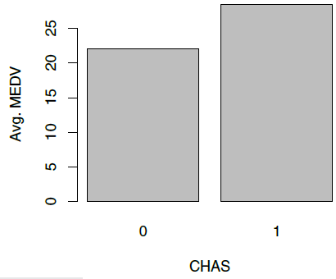
Bar Chart for Categorical Variable Average median neighborhood value for neighborhoods that do and do not border the Charles River
## barchart of CHAS vs. mean MEDV
# compute mean MEDV per CHAS = (0, 1)
data.for.plot <- aggregate(housing.df$MEDV, by = list(housing.df$CHAS), FUN = mean)
names(data.for.plot) <- c("CHAS", "MeanMEDV")
barplot(data.for.plot$MeanMEDV, names.arg = data.for.plot$CHAS,
xlab = "CHAS", ylab = "Avg. MEDV")

Slide 5
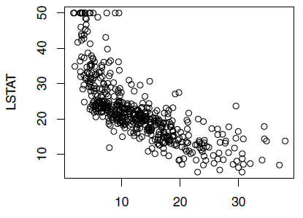
Scatterplot Displays relationship between two numerical variables
MEDV
## scatter plot with axes names
plot(housing.df$MEDV ~ housing.df$LSTAT, xlab = "MDEV", ylab = "LSTAT")

Slide 6
Distribution Plots
Display “how many” of each value occur in a data set
Or, for continuous data or data with many possible values, “how many” values are in each of a series of ranges or “bins”

Slide 7
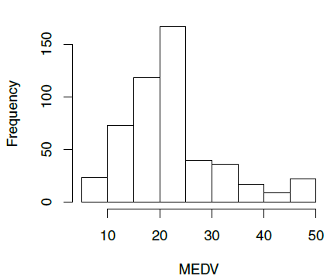
Histograms
Boston Housing example:
Histogram shows the distribution of the outcome variable (median house value)
About 40 neighborhoods had a median house value < $10,000 (these data are from mid-20th century)
## histogram of MEDV
hist(housing.df$MEDV, xlab = "MEDV")

Slide 8
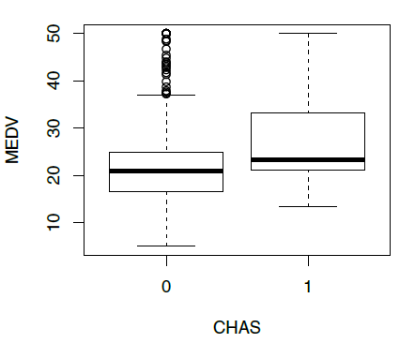
Boxplots
Side-by-side boxplots are useful for comparing subgroups
Houses in neighborhoods on Charles river (1) are more valuable than those not (0)
## boxplot of MEDV for different values of CHAS
boxplot(housing.df$MEDV ~ housing.df$CHAS, xlab = "CHAS", ylab = "MEDV")

Slide 9
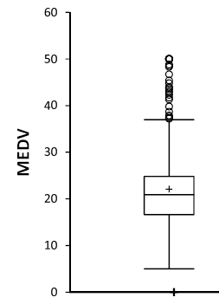
Box Plot
Top outliers defined as those above Q3+1.5(Q3-Q1).
“max” = maximum of non-outliers
Analogous definitions for bottom outliers and for “min”
Details may differ across software
outliers
“max”
Quartile 3
Median
Quartile 1
“min”

Slide 10
Heat Maps
Color conveys information
In data mining, used to visualize
Correlations
Missing Data

Slide 11
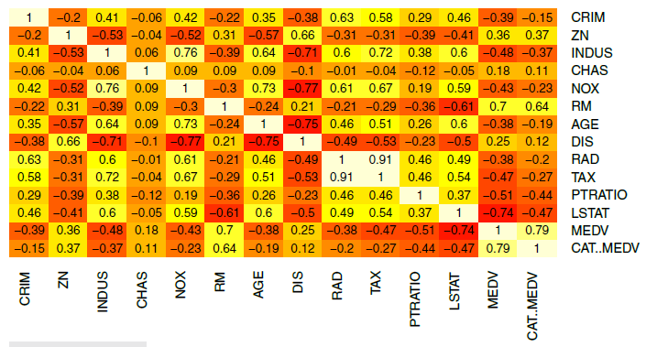
Heatmap to highlight correlations Darker & redder = more negative correlation
Lighter and yellower = more positive correlation
## simple heatmap of correlations (without values)
heatmap(cor(housing.df), Rowv = NA, Colv = NA)
## heatmap with values
library(gplots)
heatmap.2(cor(housing.df), Rowv = FALSE, Colv = FALSE, dendrogram = "none",
cellnote = round(cor(housing.df),2),
notecol = "black", key = FALSE, trace = 'none', margins = c(10,10))

Slide 12
Multidimensional Visualization

Slide 13
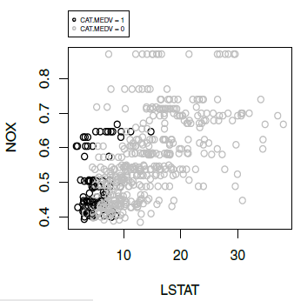
Scatterplot with color/shade added
Boston Housing
NOX vs. LSTAT
light shade = low median value
dark shade = high median value
# alternative plot with ggplot [text has more complex Base R coding too]
library(ggplot2)
ggplot(housing.df, aes(y = NOX, x = LSTAT, colour= CAT..MEDV)) +
geom_point(alpha = 0.6)

Slide 14
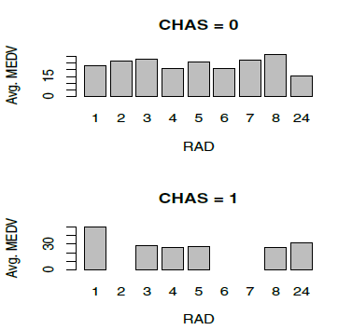
Bar chart for MEDV vs. RAD, first for low-value neighborhoods, then for high value neighborhoods
data.for.plot <- aggregate(housing.df$MEDV, by = list(housing.df$RAD,
housing.df$CHAS),FUN = mean, drop = FALSE)
ggplot(data.for.plot) +
geom_bar(aes(x = as.factor(RAD), y = `meanMEDV`), stat = "identity") +
xlab("RAD") + facet_grid(CHAS ~ .)
see Fig. 3.6 for more

Slide 15
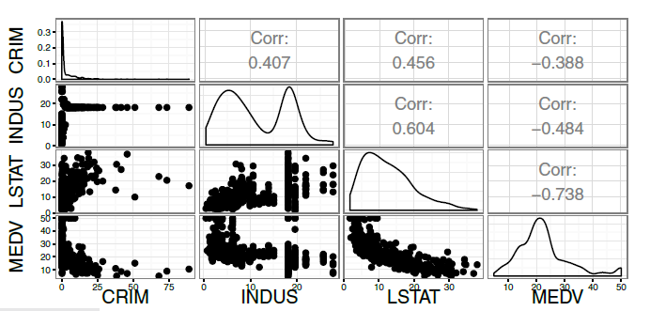
Matrix Scatterplot
Diagonal plot is the frequency distribution for the variable
## simple plot
# use plot() to generate a matrix of 4X4 panels with variable name on the diagonal,
# and scatter plots in the remaining panels.
plot(housing.df[, c(1, 3, 12, 13)])
# alternative, nicer plot (displayed)
library(GGally)
ggpairs(housing.df[, c(1, 3, 12, 13)])

Slide 16
Manipulation:
Rescaling
Aggregation
Zooming
Filtering

Slide 17
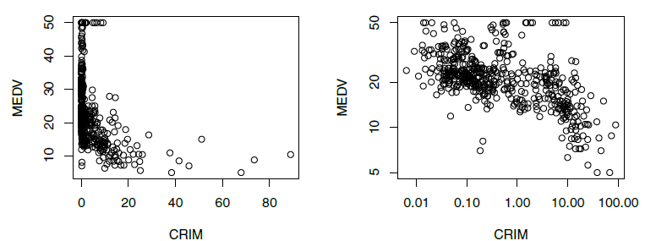
Rescaling to log scale (on right) “uncrowds” the data
## scatter plot: regular and log scale
plot(housing.df$MEDV ~ housing.df$CRIM, xlab = "CRIM", ylab = "MEDV")
# to use logarithmic scale set argument log = to either 'x', 'y', or 'xy'.
plot(housing.df$MEDV ~ housing.df$CRIM,
xlab = "CRIM", ylab = "MEDV", log = 'xy')

Slide 18
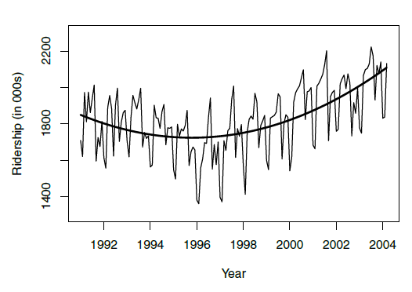
Amtrak Ridership – Monthly Data – Curve Added
## fit curve
ridership.lm <- tslm(ridership.ts ~ trend + I(trend^2))
plot(ridership.ts, xlab = "Year", ylab = "Ridership (in 000s)", ylim =
c(1300, 2300))
lines(ridership.lm$fitted, lwd = 2)

Slide 19
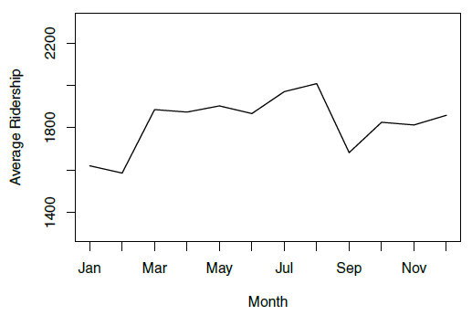
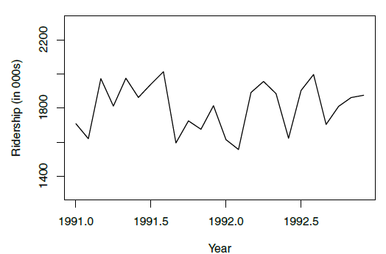
Amtrak Ridership
Monthly Average
Zoom in
## zoom in, monthly, and annual plots
ridership.2yrs <- window(ridership.ts, start = c(1991,1), end = c(1992,12))
plot(ridership.2yrs, xlab = "Year", ylab = "Ridership (in 000s)", ylim = c(1300, 2300))
monthly.ridership.ts <- tapply(ridership.ts, cycle(ridership.ts), mean)
plot(monthly.ridership.ts, xlab = "Month", ylab = "Average Ridership",
ylim = c(1300, 2300), type = "l", xaxt = 'n')
## set x labels
axis(1, at = c(1:12), labels = c("Jan","Feb","Mar", "Apr","May","Jun",
"Jul","Aug","Sep", "Oct","Nov","Dec"))
annual.ridership.ts <- aggregate(ridership.ts, FUN = mean)
plot(annual.ridership.ts, xlab = "Year", ylab = "Average Ridership",
ylim = c(1300, 2300))

Slide 20
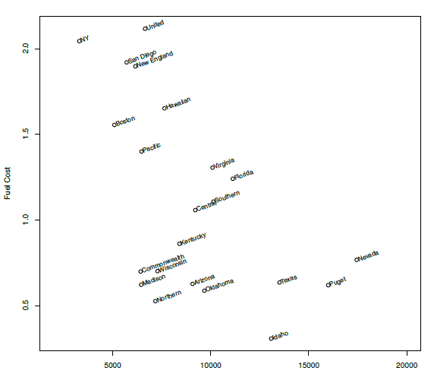
Scatter Plot with Labels (Utilities)
plot(utilities.df$Fuel_Cost ~ utilities.df$Sales,
xlab = "Sales", ylab = "Fuel Cost", xlim = c(2000, 20000))
text(x = utilities.df$Sales, y = utilities.df$Fuel_Cost,
labels = utilities.df$Company, pos = 4, cex = 0.8, srt = 20, offset = 0.2)

Slide 21
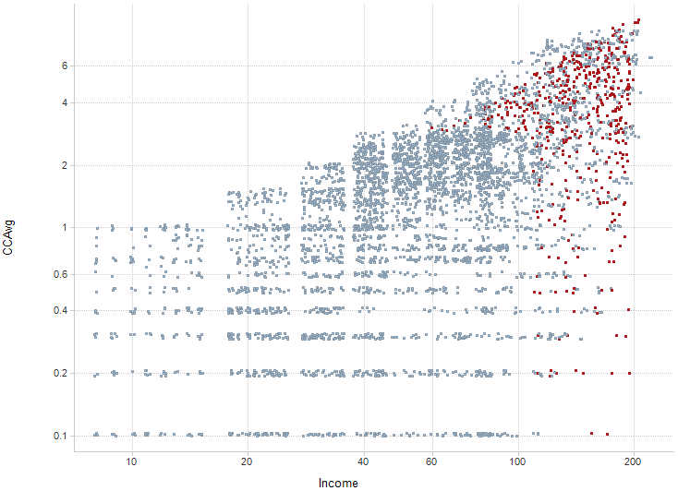
Scaling: Smaller markers, jittering, color contrast (Universal Bank; red = accept loan)
Jitter = add noise to “unstack” markers that hide markers underneath
# use function alpha() in library scales to add transparent colors
library(scales)
plot(jitter(universal.df$CCAvg, 1) ~ jitter(universal.df$Income, 1),
col = alpha(ifelse(universal.df$Securities.Account == 0, “gray", “red"), 0.4),
pch = 20, log = 'xy', ylim = c(0.1, 10),
xlab = "Income", ylab = "CCAvg")

Slide 22
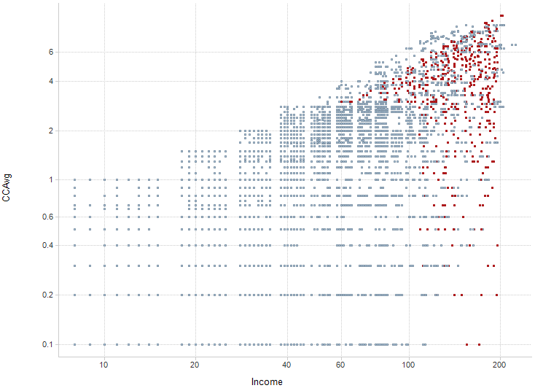
Without jittering
With jittering

Slide 23
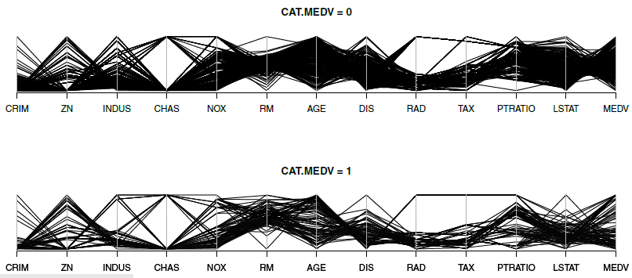
Parallel Coordinate Plot (Boston Housing)
All variables are rescaled to 0-1 scale
Each line is a single record
library(MASS)
par(mfcol = c(2,1))
parcoord(housing.df[housing.df$CAT..MEDV == 0, -14], main = "CAT.MEDV = 0")
parcoord(housing.df[housing.df$CAT..MEDV == 1, -14], main = "CAT.MEDV = 1")

Slide 24
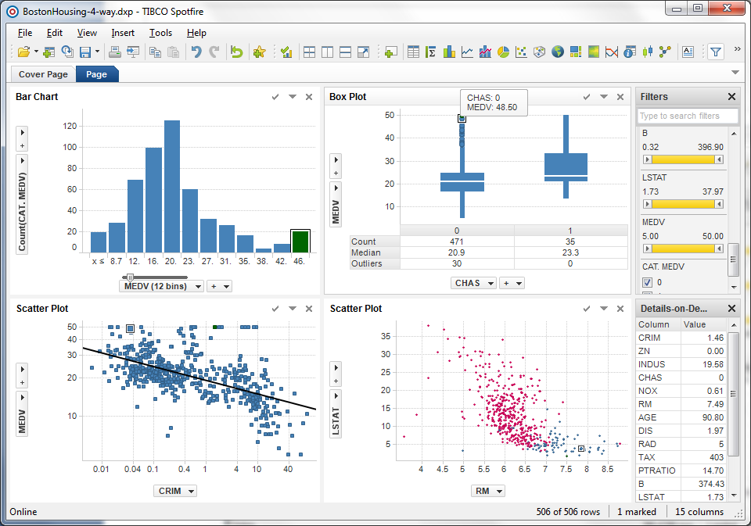
Linked plots (same record is highlighted in each plot)
Produced in Spotfire

Slide 25
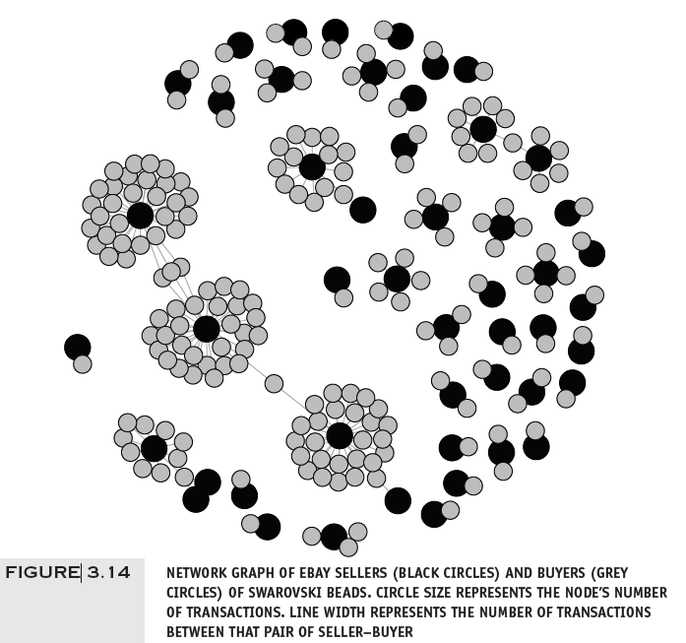
Network Graph eBay Auctions
library(igraph)
ebay.df <- read.csv("eBayNetwork.csv")
# transform node ids to factors
ebay.df[,1] <- as.factor(ebay.df[,1])
ebay.df[,2] <- as.factor(ebay.df[,2])
graph.edges <- as.matrix(ebay.df[,1:2])
g <- graph.edgelist(graph.edges, directed = FALSE)
isBuyer <- V(g)$name %in% graph.edges[,2]
plot(g, vertex.label = NA, vertex.color = ifelse(isBuyer, "gray", "black"),
vertex.size = ifelse(isBuyer, 7, 10))

Slide 26
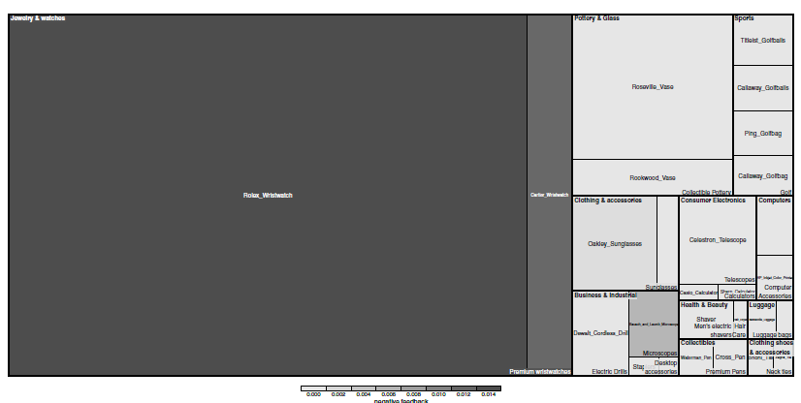
Treemap – eBay Auctions (Hierarchical eBay data: Category> sub-category> Brand)
Detail on this corner – next slide
library(treemap)
tree.df <- read.csv("EbayTreemap.csv")
# add column for negative feedback
tree.df$negative.feedback <- 1* (tree.df$Seller.Feedback < 0)
# draw treemap
treemap(tree.df, index = c("Category","Sub.Category", "Brand"),
vSize = "High.Bid", vColor = "negative.feedback", fun.aggregate = "mean",
align.labels = list(c("left", "top"), c("right", "bottom"), c("center", "center")),
palette = rev(gray.colors(3)), type = "manual", title = "")

Slide 27
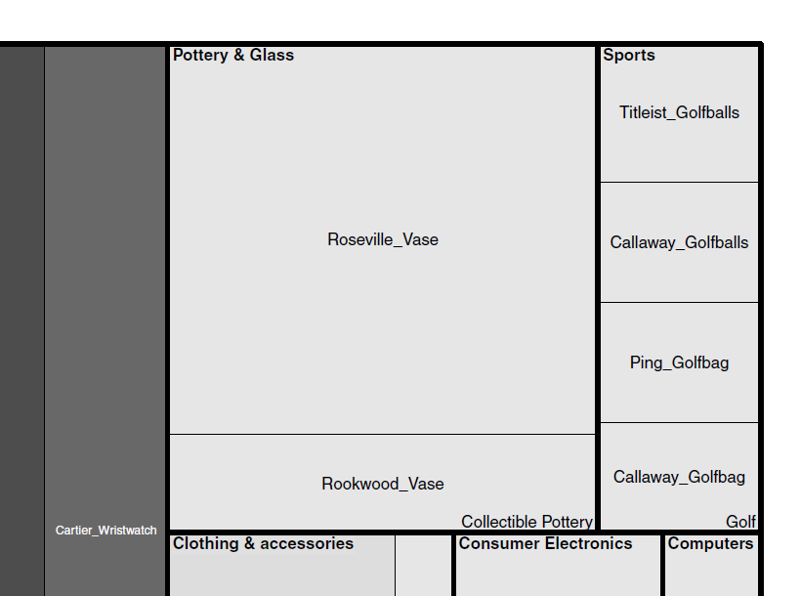
Category
Brand
Rectangle size = avg. value of item
Subcategory
Darker = more negative feedback

Slide 28
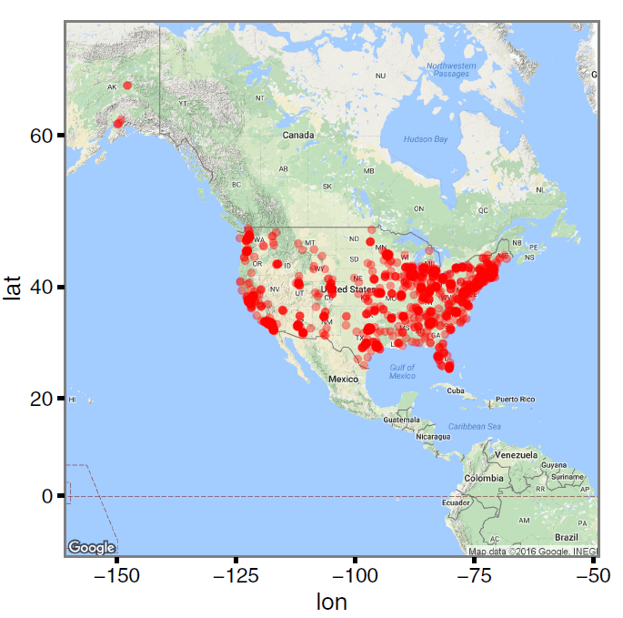
Using Google Maps
Location of Statistics.com students and instructors
library(ggmap)
SCstudents <- read.csv("SC-US-students-GPS-data-2016.csv")
Map <- get_map("Denver, CO", zoom = 3)
ggmap(Map) + geom_point(aes(x = longitude, y = latitude), data = SCstudents,
alpha = 0.4, colour = "red", size = 0.5)

Slide 29
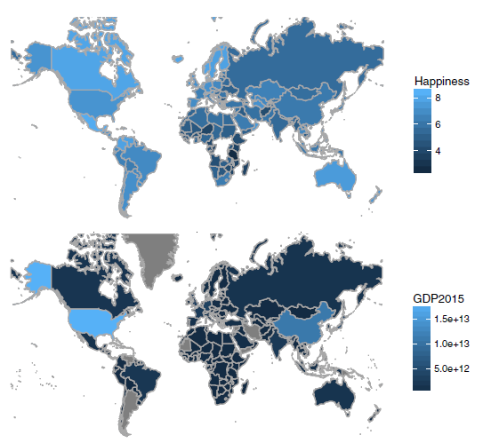
Map Chart
(Comparing countries’ well-being with GDP)
Darker = higher value
library(mosaic)
gdp.df <- read.csv("gdp.csv", skip = 4, stringsAsFactors = FALSE)
names(gdp.df)[5] <- "GDP2015"
happiness.df <- read.csv("Veerhoven.csv")
# gdp map
mWorldMap(gdp.df, key = "Country.Name", fill = "GDP2015") + coord_map()
# well-being map
mWorldMap(happiness.df, key = "Nation", fill = "Score") + coord_map() +
scale_fill_continuous(name = "Happiness")

